Slide 1


Finland25
Automation of computational chemistry workflows with AQME
June 9, 2025
Dr. Juan Vicente Alegre Requena

Slide 2
Research focus (hobby)
Future Leaders Special Issue.
Trends in Chem. 2024

Slide 3
Research focus (hobby)
Future Leaders Special Issue.
Trends in Chem. 2024

Slide 4
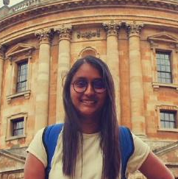
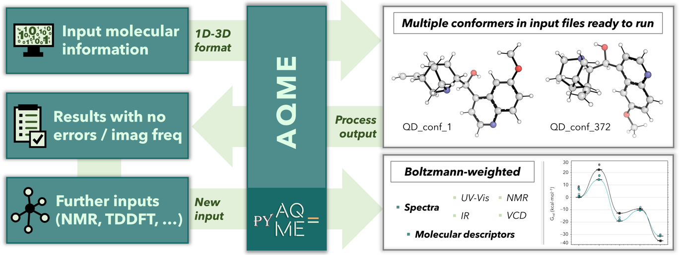
AQME: automation of QM protocols
Overview of AQME
Shree Sowndarya
Alegre-Requena, Paton & col., WIREs. Comput. Mol. Sci. 2023, e1663

Slide 5


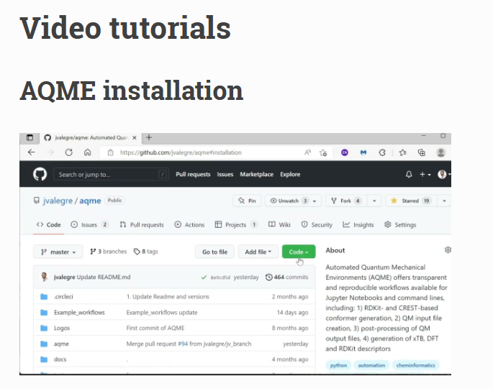
AQME: automation of QM protocols
Installation (instructions en Read the Docs)
conda install -y -c conda-forge openbabel=3.1.1
conda install -y -c conda-forge xtb=6.7.1
pip install aqme
https://aqme.readthedocs.io

Slide 6
AQME: automation of QM protocols
Future Leaders Special Issue. Trends in Chem. 2024

Slide 7
AQME: automation of QM protocols
Future Leaders Special Issue. Trends in Chem. 2024

Slide 8
AQME: automation of QM protocols
Conformer searches are tricky
What’s the most stable conformer in each case?
1: Proc. Comb. Inst. 2023, 39, 877
2, 3: Chem. Eng. J. 2023, 466, 143346.
4: Nature Commun. 2022, 13, 6885.
5: J. Am. Chem. Soc. 2022, 144, 86.
6: Chem. Eur. J. 2017, 23, 15336
7: ChemRxiv, 2023, 10.26434/chemrxiv-2023-8jzsp
Future Leaders Special Issue.
Trends in Chem. 2024

Slide 9
AQME: automation of QM protocols
Conformer searches are tricky
1: Proc. Comb. Inst. 2023, 39, 877
2, 3: Chem. Eng. J. 2023, 466, 143346.
4: Nature Commun. 2022, 13, 6885.
5: J. Am. Chem. Soc. 2022, 144, 86.
6: Chem. Eur. J. 2017, 23, 15336
7: ChemRxiv, 2023, 10.26434/chemrxiv-2023-8jzsp
Future Leaders Special Issue.
Trends in Chem. 2024

Slide 10
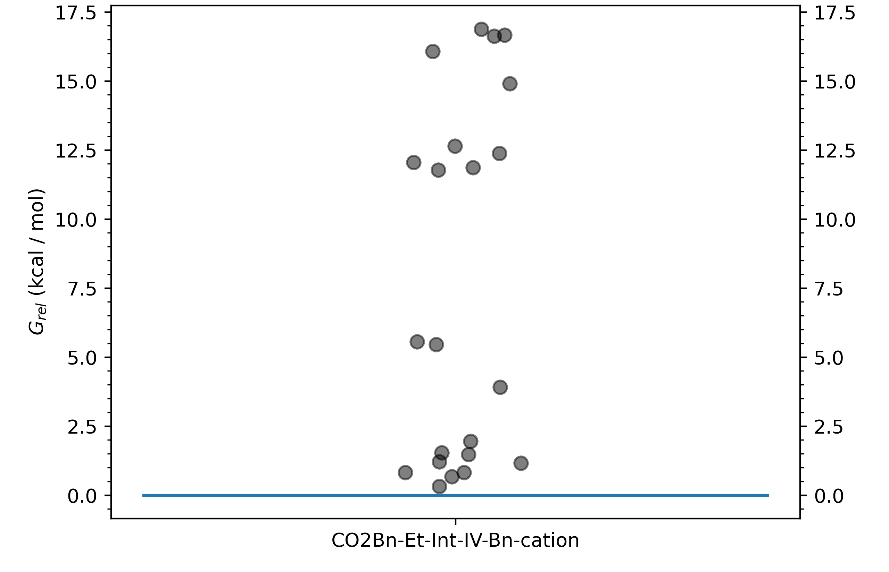
AQME: automation of QM protocols
Conformer searches are tricky
Multi-seeding auto.
1: Proc. Comb. Inst. 2023, 39, 877
2, 3: Chem. Eng. J. 2023, 466, 143346.
4: Nature Commun. 2022, 13, 6885.
5: J. Am. Chem. Soc. 2022, 144, 86.
6: Chem. Eur. J. 2017, 23, 15336
7: ChemRxiv, 2023, 10.26434/chemrxiv-2023-8jzsp
Future Leaders Special Issue.
Trends in Chem. 2024

Slide 11









AQME: stats
Users and interest
https://github.com/jvalegre/aqme
www.readthedocs.org/projects/aqme
Prof. Juho Helaja
University of Helsinki
Companies
Known active users:
Academic groups
Dr. A. Vazquez-Mayagoitia
Argonne National Lab.
WIREs. Comput. Mol. Sci. 2023, e1663

Slide 12

AQME: automation of QM protocols
Pre-compiled workflows

Slide 13
AQME: automation of QM protocols
Advanced settings of CSEARCH
program : 'rdkit', 'summ', 'fullmonte', 'crest’
sample : number of initial guesses
input : SMILES strings, CSV, SDF, XYZ, PDB, OUT/LOG
works with organometallic molecules (currently, not possible when using the RDKit library)
templates for organometallic molecules available
multi-seeding with 'crest’ : crest_nrun
constraints for TS searches : constraints_atoms, constraints_dist, constraints_angle…
charge and multiplicity by default or specified by the user

Slide 14
AQME: automation of QM protocols
Just for laughs (live demo)
Volunteers to try some SMILES (Sofia, Au complexes in ChemDraw 3D, a couple more tries)
When ChemDraw says no (red warnings), it’s no!
Some tips when using organometallic SMILES

Slide 15
AQME: automation of QM protocols
Future Leaders Special Issue. Trends in Chem. 2024

Slide 16
AQME: automation of QM protocols
Bread and butter for automation
Same precision as humans
Just need to press “enter”
Way faster (1,000 calcs ~ 5 s)
Examples: single-point corrections, TD-DFT, NBO calcs, etc.
Future Leaders Special Issue. Trends in Chem. 2024

Slide 17
AQME: automation of QM protocols
Advanced settings of QPREP
QM inputs for : gaussian, orca, pySCF
input : SDF, XYZ, PDB, OUT/LOG (single-point E corrections, TD-DFT vertical E, NBO, etc)
suffix/prefix available
for SDF with many conformers, take the n most stable (lowest_n) or E threshold (e_threshold_qprep)
charge and multiplicity read from CSEARCH or specified by the user
add keyword line, CHK, nprocs, memory, final lines, GenECP, etc etc

Slide 18
AQME: automation of QM protocols
Future Leaders Special Issue. Trends in Chem. 2024

Slide 19
AQME: automation of QM protocols
Bread and butter for automation
Same precision as humans in most cases
Just need to press “enter”
Way faster (100 calcs ~ 5 min)
But we’re not there yet
Difficult TSs and intermediates need manual fixing
Future Leaders Special Issue. Trends in Chem. 2024

Slide 20
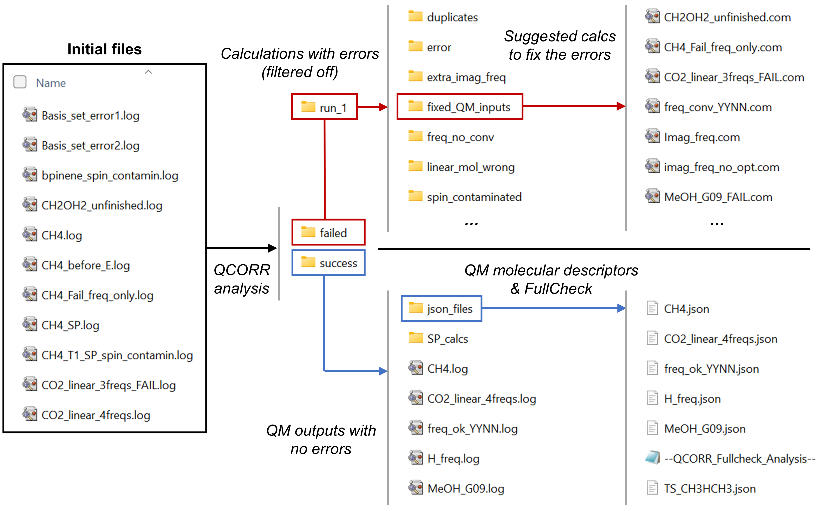
AQME: automation of QM protocols

Slide 21
AQME: automation of QM protocols
Advanced settings of QCORR
standard analysis : gaussian, orca, & other software from cclib
corrects errors : gaussian
full-check function
isomerization filters
custom thresholds to fix errors (i.e. freq displacement of imaginary freqs)
errors separated not fixed : spin contamination, isommerization, basis set error, etc. (human needed)

Slide 22
AQME: automation of QM protocols
Future Leaders Special Issue. Trends in Chem. 2024

Slide 23
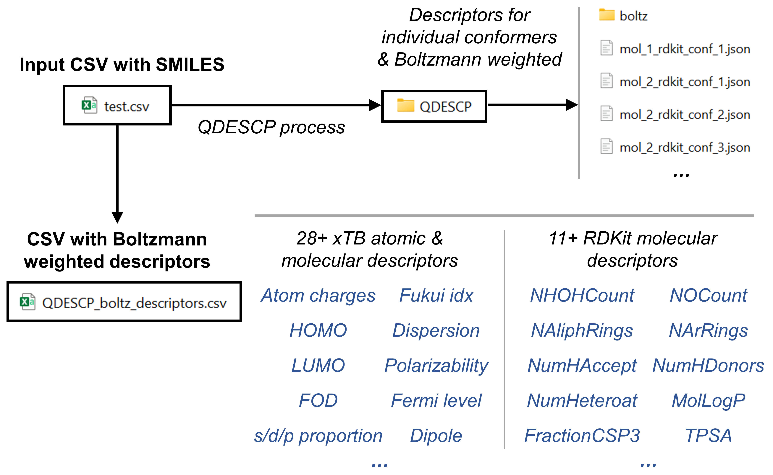
AQME: automation of QM protocols

Slide 24
AQME: automation of QM protocols
Advanced settings of QDESCP
standard descriptors : 200+ RDKit (molecular), 20+ (xTB)
option to add DBSTEP steric atomic descriptors
by default, optimized with xTB (optional)
created CSV databases ready for ROBERT

Slide 25
AQME: automation of QM protocols
Alternatives to AQME
Future Leaders Special Issue. Trends in Chem. 2024

Slide 26
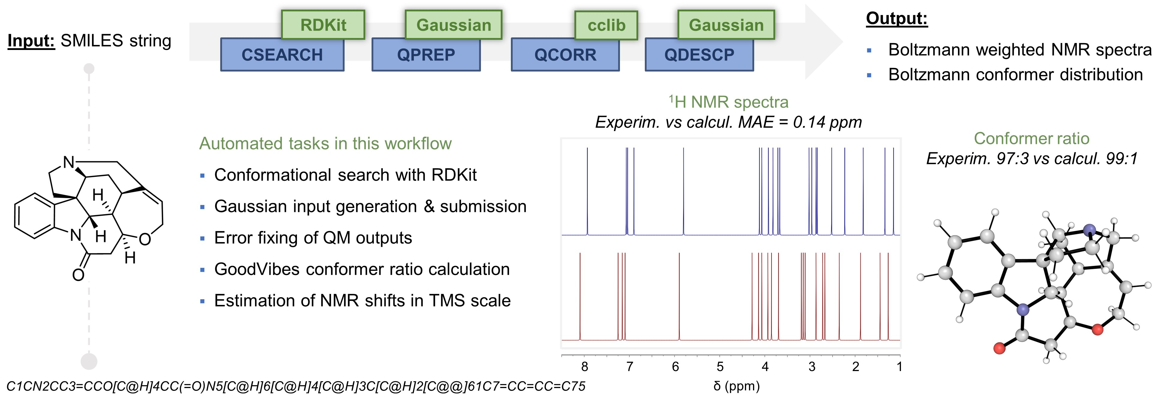
AQME: automation of QM protocols
End-to-end workflows
sbatch AQME_script.sh
Alegre-Requena, Paton & col., WIREs. Comput. Mol. Sci. 2023, e1663

Slide 27
AQME: automation of QM protocols
End-to-end workflows
sbatch AQME_script.sh
Alegre-Requena, Paton & col., WIREs. Comput. Mol. Sci. 2023, e1663

Slide 28
AQME: automation of QM protocols
End-to-end workflows
CESGA users, you can just change SMILES and run!
Also, you can edit the AQME commands and run
sbatch AQME_script.sh
Alegre-Requena, Paton & col., WIREs. Comput. Mol. Sci. 2023, e1663

